Slide 1






Slide 2


AUTOMATED END-TO-END
TESTING WITH NIGHTWATCH.js
Vladimir Roudakov
29 Sep 2016
Front End
bit.ly/dce16-nwatch

Slide 3











Vladimir ROUDAKOV
bit.ly/dce16-nwatch
@VladimirAus

Slide 4

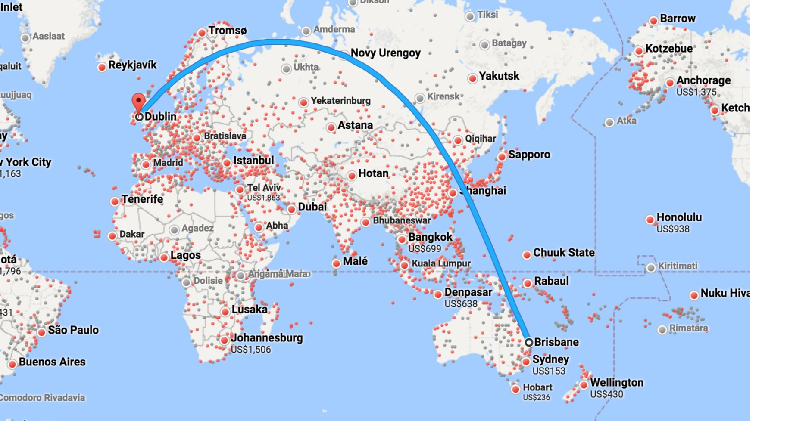

Slide 5



Prologue
WHY TESTING?

Slide 6





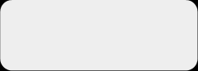
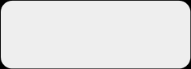





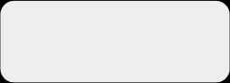


SOFTWARE DEVELOPMENT CYCLE
REQUIREMENTS
IMPLEMENTATION
TESTS

Slide 7


1. Requirements
●
Search for surname
●
Display person’s information

Slide 8
2. Manual test
●
Go to search engine
●
Type surname into search box
●
Check for result in right hand side area

Slide 9

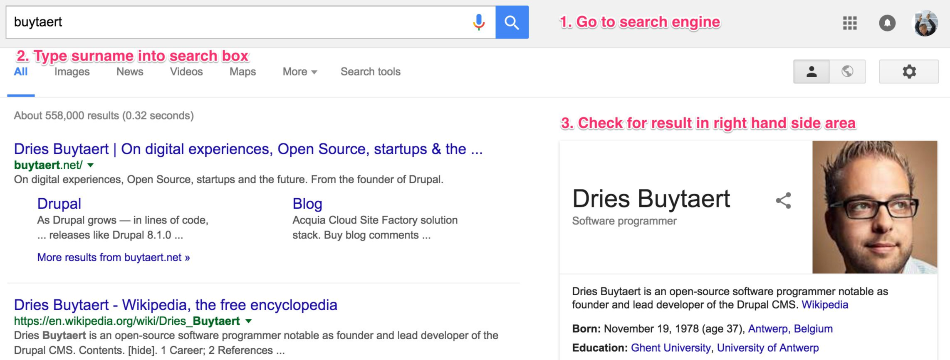

Slide 10
3. Automated test
●
A:
URL is available and
<body> is visible
●
B:
Search button is visible
●
Enter surname and click search
●
C:
Right hand side area is visible
●
D:
Right hand side area contains person’s details

Slide 11



module.exports = {
'As a user I want to see name prediction in right hand side block' :
function (browser) {
browser
.url('http://www.google.com')
.waitForElementVisible('body', 1000)
.setValue('input[type=text]', 'buytaert')
.waitForElementVisible('button[name=btnG]', 1000)
.click('button[name=btnG]')
.waitForElementVisible('#rhs_block', 1000)
.assert.containsText('#main', 'Dries Buytaert')
.end();
}
};

Slide 12

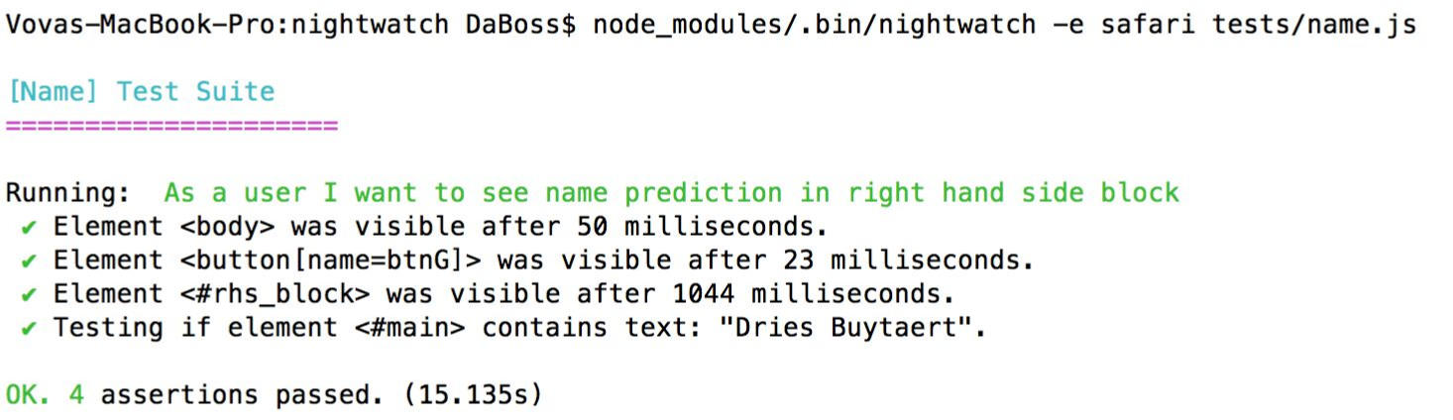
4. Running the test

Slide 13

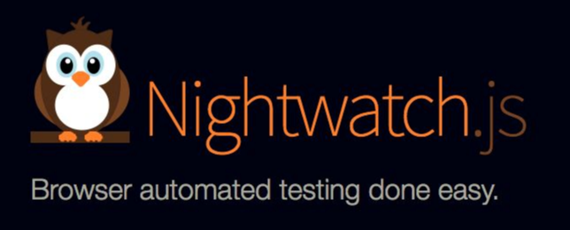


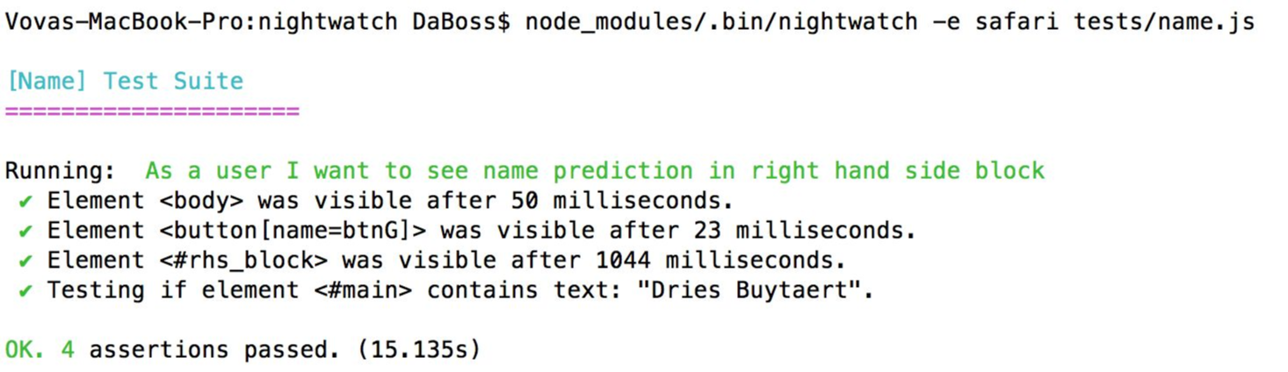
1. Command line test runner

Slide 14
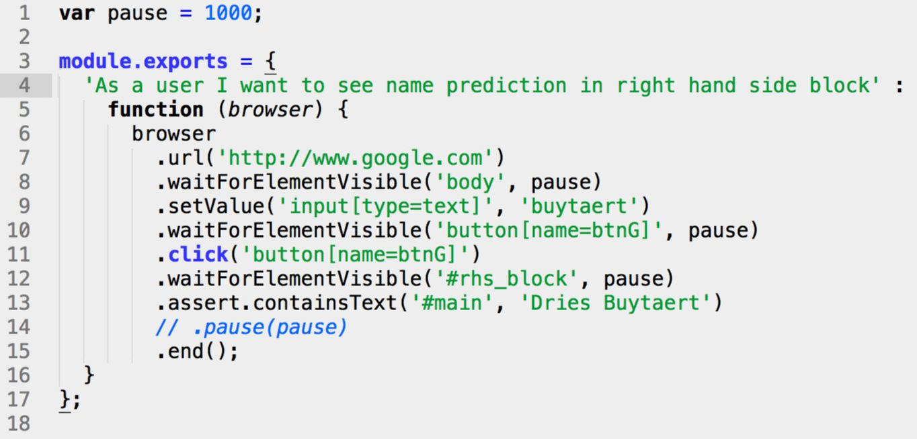

2. Tests are in JavaScript

Slide 15

3. Uses CSS selectors
● input[type=text]
● button[name=btnG]
● #rhs_block
● #main

Slide 16
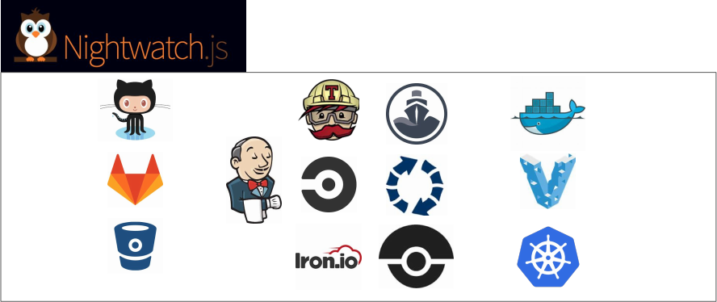

4. Continuous Integration
support

Slide 17

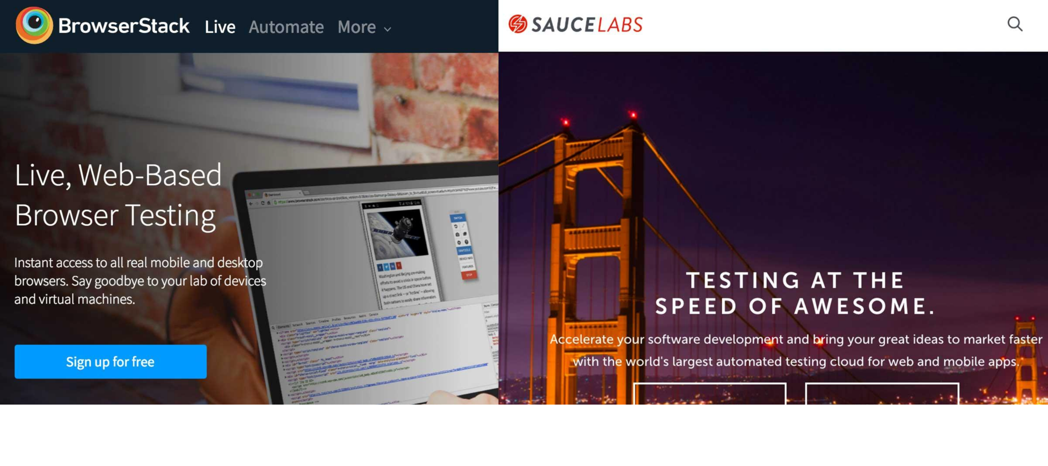
5. Cloud services
support

Slide 18
6. Easy to extend
●
Custom commands
●
Custom assertions
●
Custom reporters

Slide 19
REPORTS

Slide 20






STANDARD PROCESS
F1
F1
F2
Developer

Slide 21











STANDARD PROCESS
F2 ready?
F3, ...
Sure
F1
F1
F1
PM
F2
F2
Developer

Slide 22




STANDARD PROCESS
F2 ready?
F3, ...
Sure
F1
F1
F1
PM
F2
F2
Developer
Great!
To production!
BA

Slide 23





STANDARD PROCESS
F2 ready!
F2 ready?
F3, ...
Great!
Sure
F1
F1
F1
PM
F2
F2
Client
Developer
Great!
To production!
BA

Slide 24


STANDARD PROCESS
F2 ready!
F2 ready?
F3, ...
Great!
Sure
F1
F1
F1
PM
F2
F2
F1?
Client
Developer
Great!
To production!
BA

Slide 25

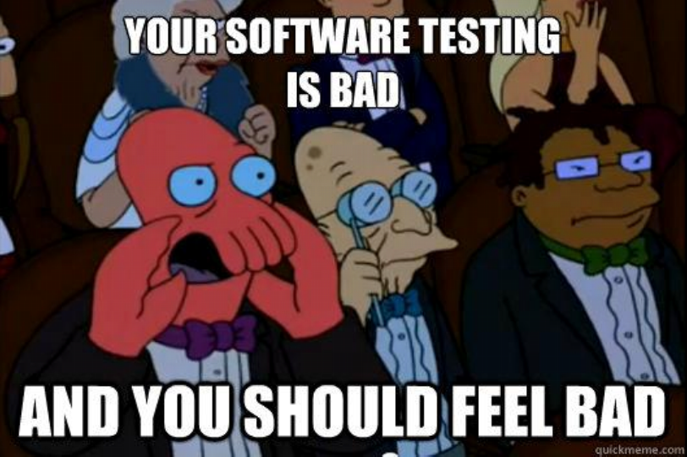

Slide 26



ADDING AUTOMATED TESTING
F1
F1
PM
F2
Client
Developer
BA

Slide 27






ADDING AUTOMATED TESTING
F1
F1
PM
F2
Client
Developer
BA

Slide 28
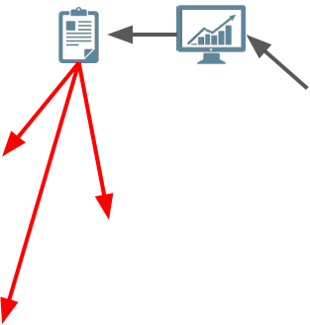
ADDING AUTOMATED TESTING
F1
F1
PM
F2
Client
Developer
BA

Slide 29




ADDING AUTOMATED TESTING
F2 ready?
F1
F1
PM
F2
Client
Developer
Yes, but F1 is
broken...
BA

Slide 30



Slide 31
Who like reports?
DEVELOPERS
Technical detailed report on
●
New features and existing functionality
●
Integration on latest test environment and UAT
●
Sprint retrospective

Slide 32
Who like reports?
INTERNAL TEAM: Managers, PMs, BAs
Report with less technical details on multiple environments
●
Track sprint /
release progress
●
Measure velocity
●
Integrate with internal tools: email, chat

Slide 33
Who like reports?
CLIENTS
Report with no technical details on pre release environment
●
Test coverage
●
Ability to identify missing /
not clarified features

Slide 34
Report output
●
Visual
●
Command line
●
JUnit XML
●
Custom reporters, e.g. JSON

Slide 35

TESTS

Slide 36
Nightwatch tests
●
Written in JavaScript
●
Each test can have multiple assertions

Slide 37
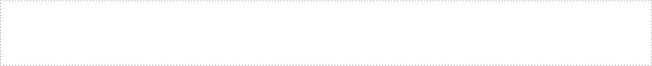

module.exports = {
'As a user I want to see name prediction in right hand side block' :
function (browser) {
browser
.url('http://www.google.com')
.waitForElementVisible('body', 1000)
.setValue('input[type=text]', 'buytaert')
.waitForElementVisible('button[name=btnG]', 1000)
.click('button[name=btnG]')
.waitForElementVisible('#rhs_block', 1000)
.assert.containsText('#main', 'Dries Buytaert')
.end();
}
};

Slide 38
module.exports = {
'As a user I want to see name prediction in right hand side block' :
function (browser) {
browser
.url('http://www.google.com')
.waitForElementVisible('body', 1000)
.setValue('input[type=text]', 'buytaert')
.waitForElementVisible('button[name=btnG]', 1000)
.click('button[name=btnG]')
.waitForElementVisible('#rhs_block', 1000)
.assert.containsText('#main', 'Dries Buytaert')
.end();
}
};

Slide 39
module.exports = {
'As a user I want to see name prediction in right hand side block' :
function (browser) {
browser
.url('http://www.google.com')
.waitForElementVisible('body', 1000)
.setValue('input[type=text]', 'buytaert')
.waitForElementVisible('button[name=btnG]', 1000)
.click('button[name=btnG]')
.waitForElementVisible('#rhs_block', 1000)
.assert.containsText('#main', 'Dries Buytaert')
.end();
}
};

Slide 40
module.exports = {
'As a user I want to see name prediction in right hand side block' :
function (browser) {
browser
.url('http://www.google.com')
.waitForElementVisible('body', 1000)
.setValue('input[type=text]', 'buytaert')
.waitForElementVisible('button[name=btnG]', 1000)
.click('button[name=btnG]')
.waitForElementVisible('#rhs_block', 1000)
.assert.containsText('#main', 'Dries Buytaert')
.end();
}
};

Slide 41
module.exports = {
'As a user I want to see name prediction in right hand side block' :
function (browser) {
browser
.url('http://www.google.com')
.waitForElementVisible('body', 1000)
.setValue('input[type=text]', 'buytaert')
.waitForElementVisible('button[name=btnG]', 1000)
.click('button[name=btnG]')
.waitForElementVisible('#rhs_block', 1000)
.assert.containsText('#main', 'Dries Buytaert')
.end();
}
};

Slide 42
module.exports = {
'As a user I want to see name prediction in right hand side block' :
function (browser) {
browser
.url('http://www.google.com')
.waitForElementVisible('body', 1000)
.setValue('input[type=text]', 'buytaert')
.waitForElementVisible('button[name=btnG]', 1000)
.click('button[name=btnG]')
.waitForElementVisible('#rhs_block', 1000)
.assert.containsText('#main', 'Dries Buytaert')
.end();
}
};

Slide 43

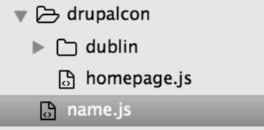
Nightwatch tests
●
Each file can have multiple tests
●
Each folder can have multiple folders and files

Slide 44
Nightwatch tests
●
Group tests according to functionality
●
Tag your tests for better granular testing

Slide 45
module.exports = {
'@tags': ['sprint3', 'issue 15674'],
'demo login test': function (browser) {
// test code
}
};

Slide 46
ENVIRONMENT

Slide 47




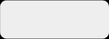
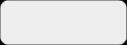
















Local environment - selenium
scripts
driver

Slide 48
Selenium
●
Selenium is a suite of tools to automate web browsers across
many platforms.
●
Supports many operating systems
●
Runs as a server on Java
●
Writing tests is complicated

Slide 49
...
"selenium" : {
"start_process" : false,
"server_path" : "/usr/local/.../seleniumserver2.jar",
"log_path" : "",
"host" : "127.0.0.1",
"port" : 4444,
"cli_args" : {
"webdriver.chrome.driver" : "./chromedriver",
"webdriver.gecko.driver" : "./geckodriver",
"webdriver.ie.driver" : ""
}
...

Slide 50

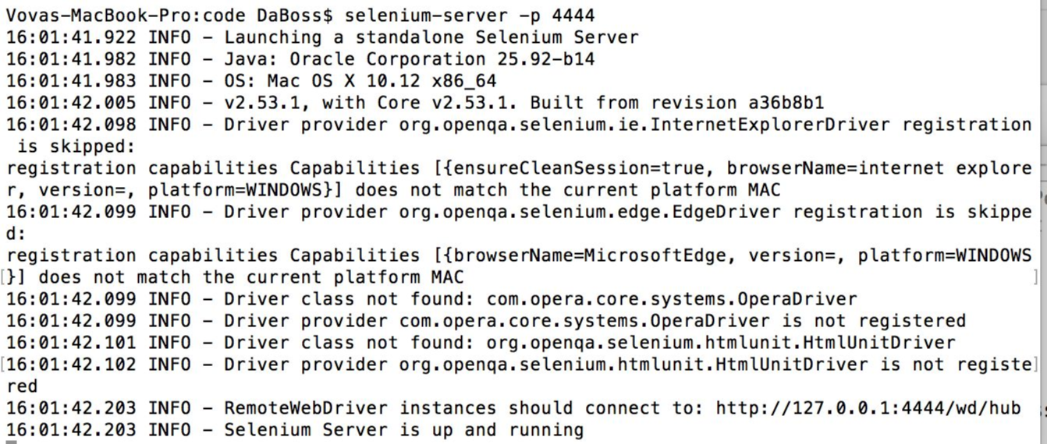

Slide 51
Selenium web driver
Allows selenium to use native browser engines
●
Firefox -
new Gecko driver
●
Safari -
requeres
●
chrome
●
IE /
edge browser -
ability to run IE in linux
●
PhantomJS

Slide 52

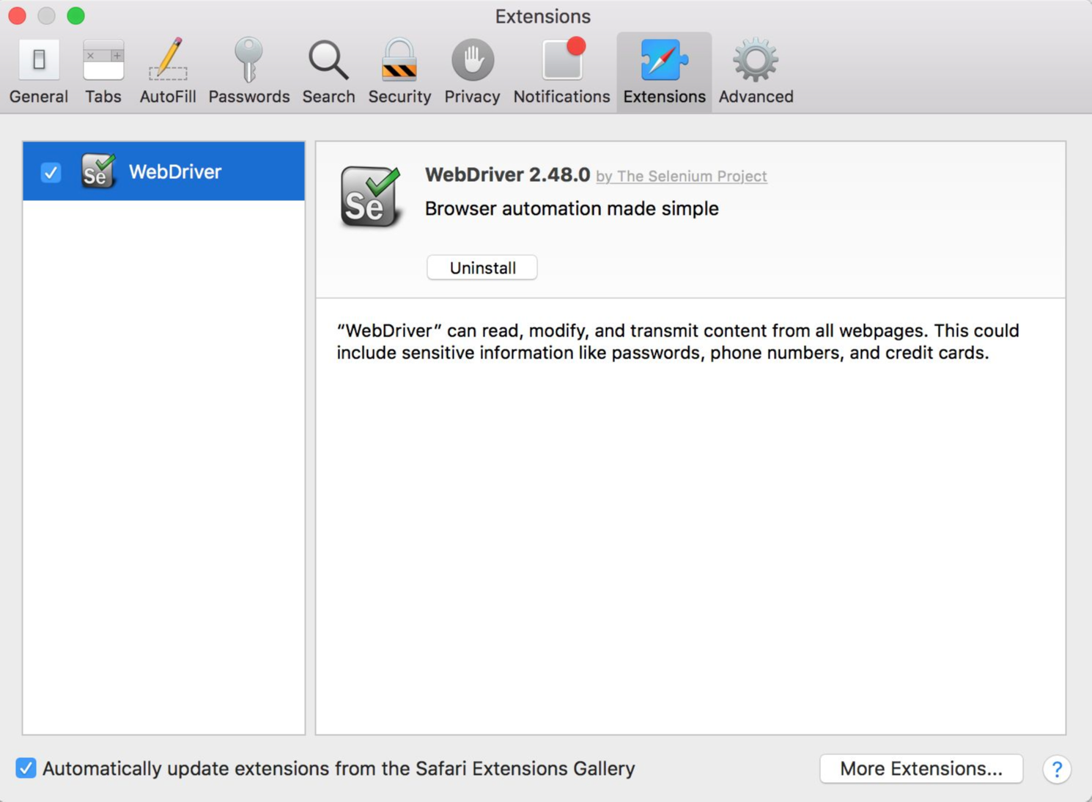

Slide 53
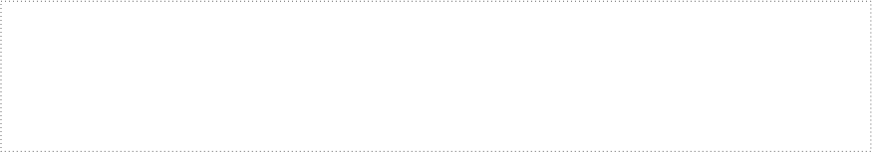

...
"selenium" : {
"start_process" : false,
"server_path" : "/usr/local/.../seleniumserver2.jar",
"log_path" : "",
"host" : "127.0.0.1",
"port" : 4444,
"cli_args" : {
"webdriver.chrome.driver" : "./chromedriver",
"webdriver.gecko.driver" : "./geckodriver",
"webdriver.ie.driver" : ""
}
...

Slide 54








No desktop environment - Xvfb
scripts
driver

Slide 55
Xvfb
●
Virtual screen to run browser
●
Native functionality

Slide 56
















Using cloud services
scripts

Slide 57

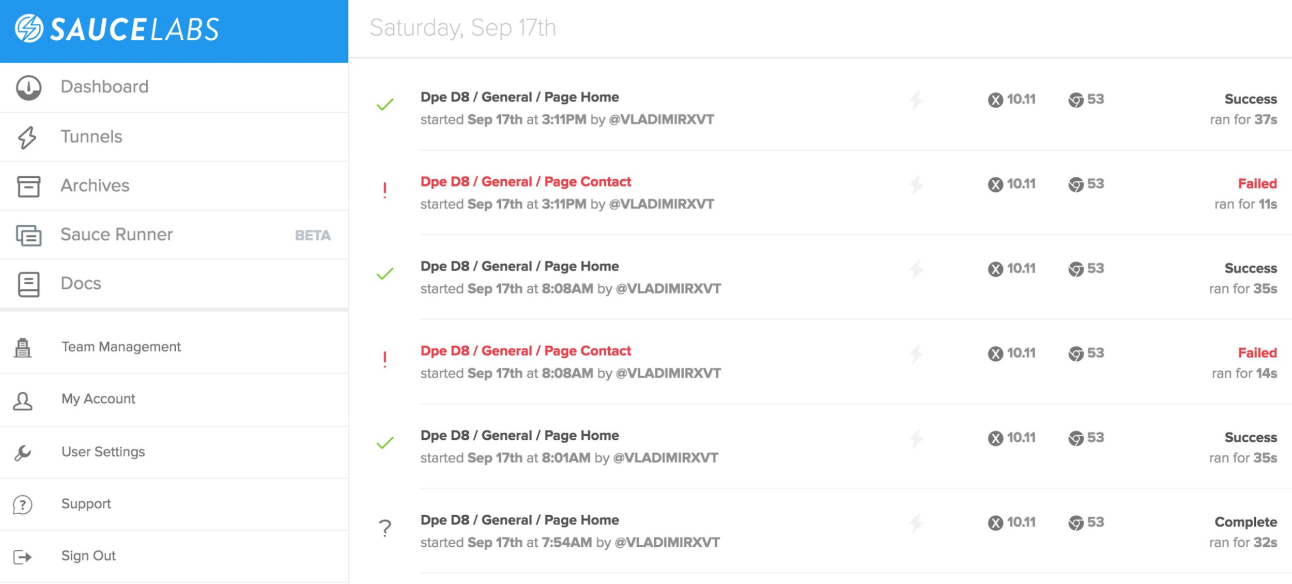

Slide 58
"selenium" : {
"start_process" : false,
"host": "ondemand.saucelabs.com",
"port": 80
},
"test_settings" : {
"default" : {
"output": true,
"selenium_host": "ondemand.saucelabs.com",
"selenium_port": 80,
"username": "${SAUCE_USERNAME}",
"access_key": "${SAUCE_ACCESS_KEY}",
"desiredCapabilities": {
"browserName": "chrome",
"platform": "Windows 10",
"version": "48"
}

Slide 59
"selenium" : {
"start_process" : false,
"host": "ondemand.saucelabs.com",
"port": 80
},
"test_settings" : {
"default" : {
"output": true,
"selenium_host": "ondemand.saucelabs.com",
"selenium_port": 80,
"username": "${SAUCE_USERNAME}",
"access_key": "${SAUCE_ACCESS_KEY}",
"desiredCapabilities": {
"browserName": "chrome",
"platform": "Windows 10",
"version": "48"
}

Slide 60
"selenium" : {
"start_process" : false,
"host": "ondemand.saucelabs.com",
"port": 80
},
"test_settings" : {
"default" : {
"output": true,
"selenium_host": "ondemand.saucelabs.com",
"selenium_port": 80,
"username": "${SAUCE_USERNAME}",
"access_key": "${SAUCE_ACCESS_KEY}",
"desiredCapabilities": {
"browserName": "chrome",
"platform": "Windows 10",
"version": "48"
}

Slide 61
Epilogue
WHY NIGHTWATCH.js?

Slide 62
Conclusion
●
Command line test runner
●
Uses JavaScript
●
Uses CSS selectors /
XPath
●
Continuous Integration support
●
Cloud services support

Slide 63
Advantages
●
Test ANY website
●
Complements unit testing
●
Various reports
●
Visual artifacts (screenshots, videos)
●
CI /
Cloud services support

Slide 64
Disadvantages
●
Takes time for initial setup
●
Basic cording knowledge required

Slide 65
Resources
●
http://nightwatchjs.org/
●
https://github.com/nightwatchjs/nightwatch
●
http://www.seleniumhq.org/
●
http://www.saucelabs.com/

Slide 66

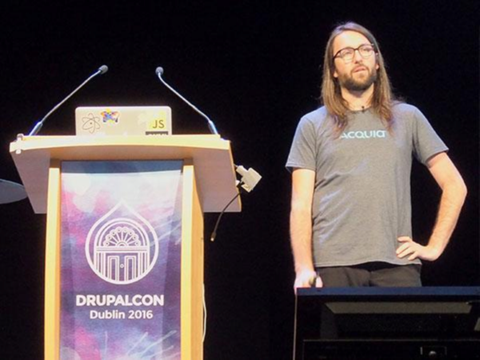

More resources
JavaScript Unit Testing
Matthew Grill
https://events.drupal.org/dublin2016/sessions/javascript-unit-testing

Slide 67




events.drupal.org/dublin2016/schedule
Evaluate This Session
THANK YOU!

Slide 68



QUESTIONS?
bit.ly/dce16-nwatch
@VladimirAus

